Slide 1


Introduction to LLM Agents
with LangChain
x
Ana Chaloska Maria Bader, PhD
25 June 2024

Slide 2


Who are we?

Slide 3

A big shoutout to …
… PyLadies Amsterdam, for building this community
… #Mollie and Ksenia Zvereva (Mollie Developer Community) for hosting us
… #women-at-mollie and #data for support
…. The awesome volunteers that helped us set up and prepare the workshop
…. YOU - for joining and making this a success!

Slide 4

Workshop goals
Understand how LLMs can perform tasks beyond text generation
Grasp the fundamental components of an LLM Agent
Build an LLM Agent with LangChain, starting from the individual components
Look beyond packages at the core structure of an agent
coding / theory

Slide 5
What LLMs can do
Question-answering (e.g. MollieGPT)
Text summarization
Sentiment analysis
Generate code
Translate text
Generate embeddings (BCC Classifier)
etc
Notes:
Initially, LLMs allow question-answering with string input and output -> Usecase MollieGPT
Since models like gpt 3.5, gpt 4 and Gemini, LLMs can also execute function calls (eg API calls etc)

Slide 6
What LLMs can’t do
Usually computational/mathematical tasks
Awareness about real-time information
Provide non-text output
Notes:
Initially, LLMs allow question-answering with string input and output -> Usecase MollieGPT
Since models like gpt 3.5, gpt 4 and Gemini, LLMs can also execute function calls (eg API calls etc)

Slide 7
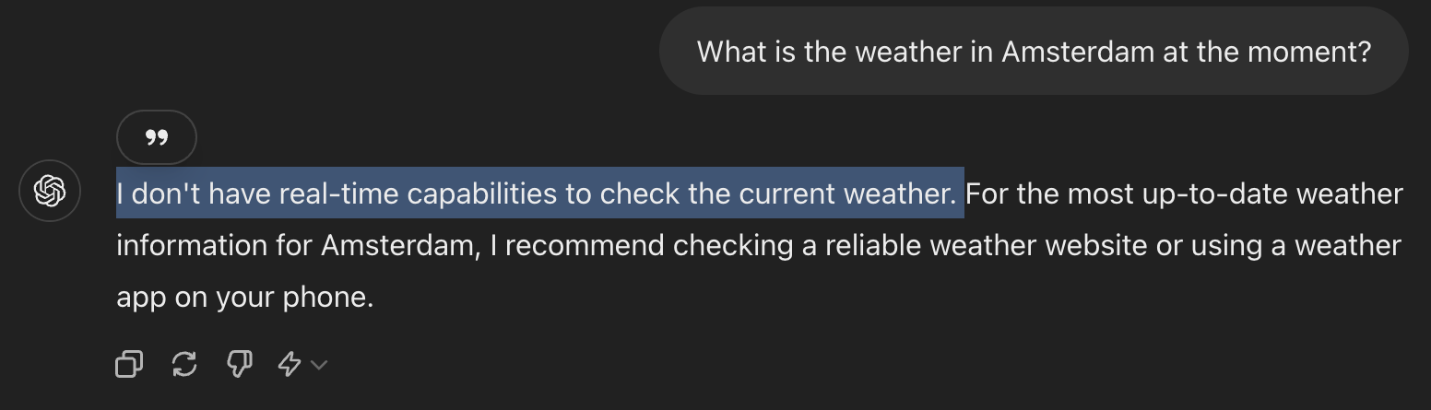

What LLMs can’t do
Notes:
Initially, LLMs allow question-answering with string input and output -> Usecase MollieGPT
Since models like gpt 3.5, gpt 4 and Gemini, LLMs can also execute function calls (eg API calls etc)

Slide 8
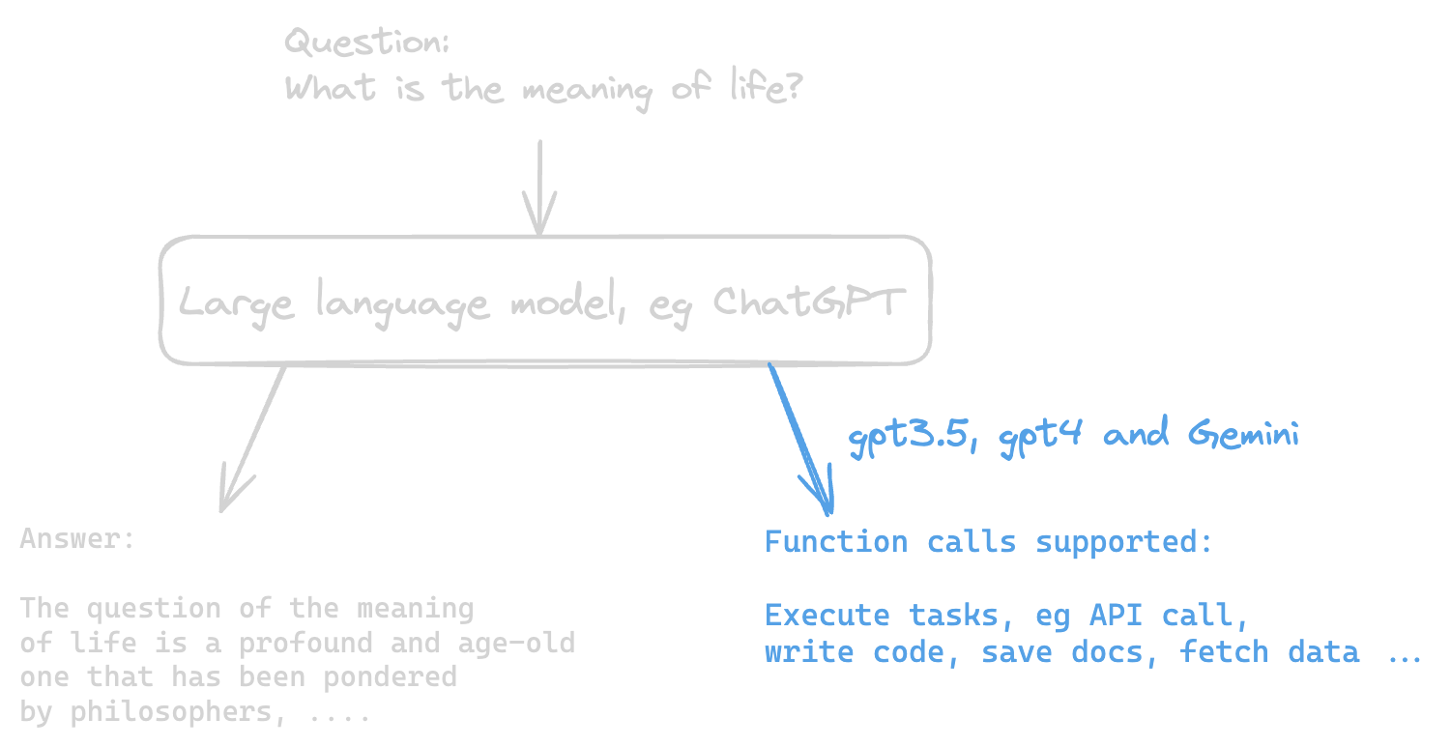
Can we help LLMs?
Yes.
How?
Nowadays there are LLMs that handle not only text but also function calls (logic in a function, API etc).
Notes:
Initially, LLMs allow question-answering with string input and output -> Usecase MollieGPT
Since models like gpt 3.5, gpt 4 and Gemini, LLMs can also execute function calls (eg API calls etc)

Slide 9
LLM Agents
LLM
Tool (Function, API)
E.g. Access to current weather information
LLM Agent

Slide 10
LLM Agents
Tool 1
E.g. Access to current weather information
LLM
Tool 2
E.g. Access to Airline API with current ticket prices
LLM Agent

Slide 11
LLM Agents
Tool 1
LLM
Tool 2
…
Tool n
LLM Agent

Slide 12
LLM Agents
LLM Agent
User Prompt
LLM
Tool(s)
Text Answer
System prompt (instruction)

Slide 13
LLM Agents
LLM Agent
Prompt:
What is the temperature in Amsterdam?
LLM: GPT3.5 Turbo
Tool:
Weather Tool
Text Answer:
The temperature is 16 degrees.
System prompt:
You are a helpful assistant.
Weather API

Slide 14
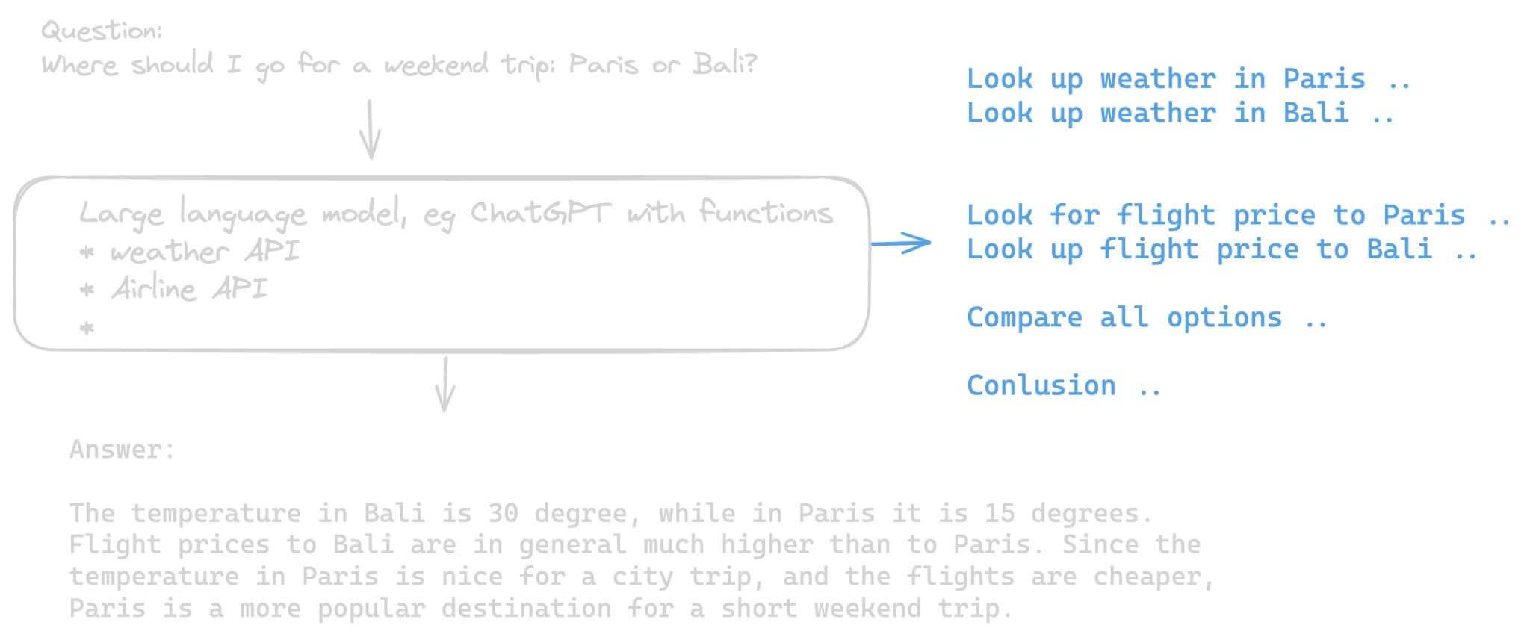
LLM agents
LLM choses from a list of provided functions which actions to take to complete a task.
Notes:
LLM agents utilize the function calling functionality of LLMS to chose from a set of provided tools/functions which tasks

Slide 15
Getting started with
the workshop

Slide 16

The use case
Summer holidays are coming up and you still don't know where to go. Oh no!
You decide to build a tool that helps you get information on holiday locations. For example, you would like to to find out how big a specific city is, what sights are there to see, how the weather there is, and you would like to get a drawing of that place, to get a first impression. Because who does not like art?
You will implement this through an LLM agent, who has access to
the wikipedia API,
the virtual crossing weather API,
the HuggingFace API to generate images.
Notes:
LangChain is a framework for developing applications powered by large language models (LLMs).

Slide 17


Our toolbox
ChatGPT 3.5 turbo [API reference]
Framework for developing LLM applications
Integrations for all common chat models,
Retrievers and vector stores,
Toolkits, RAG and Agent wrappers,
Tutorials
Notes:
LangChain is a framework for developing applications powered by large language models (LLMs).

Slide 18
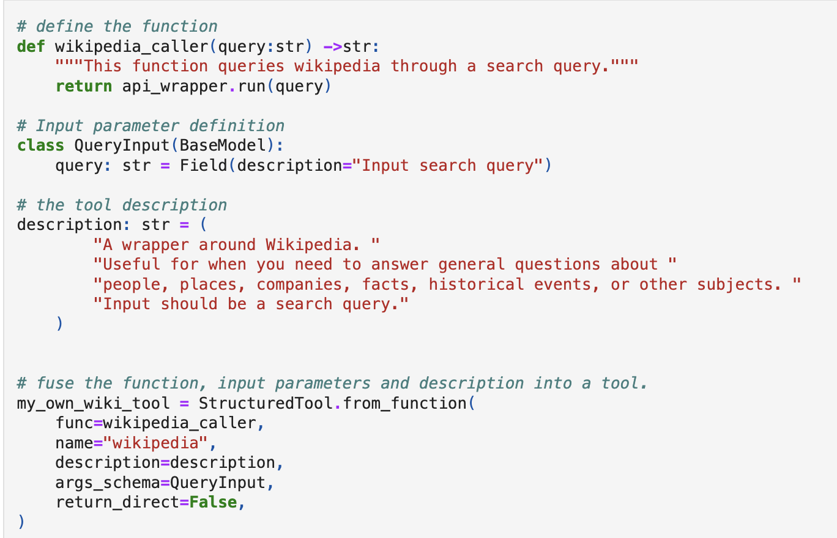
What are tools?
Tools are interfaces that an LLM can use to interact with the world.
Function
Input schema
Description
Create tool with StructuredTool class
Name
Return result directly to user?

Slide 19



Let’s get coding
Option 1: Local Jupyter Lab
Clone this git repo
Follow these steps to set up the environment
Copy the API keys here to helper_functions/keys.py
Open 1_workshop_tools.ipynb and start coding!
Option 2: Google Colab
In google colab > open notebook > github > paste the repository link > click on “1_workshop_tools.ipynb”
Copy the code here into the first cell of the notebook and compile it.
Copy the API keys here to helper_functions/keys.py
You are ready to start
Link to the repo
Link to the slides

Slide 20
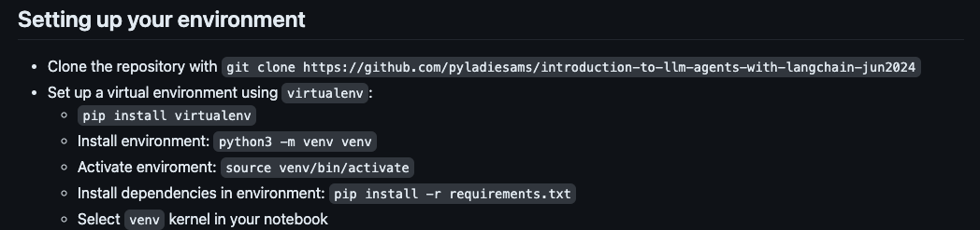

Slide 21

Time for a short break

Slide 22
LLM Agents
LLM Agent
Prompt:
What is the temperature in Amsterdam?
LLM: GPT3.5 Turbo
Tool:
Weather Tool
Text Answer:
The temperature is 16 degrees.
System prompt:
You are a helpful assistant.
Weather API

Slide 23
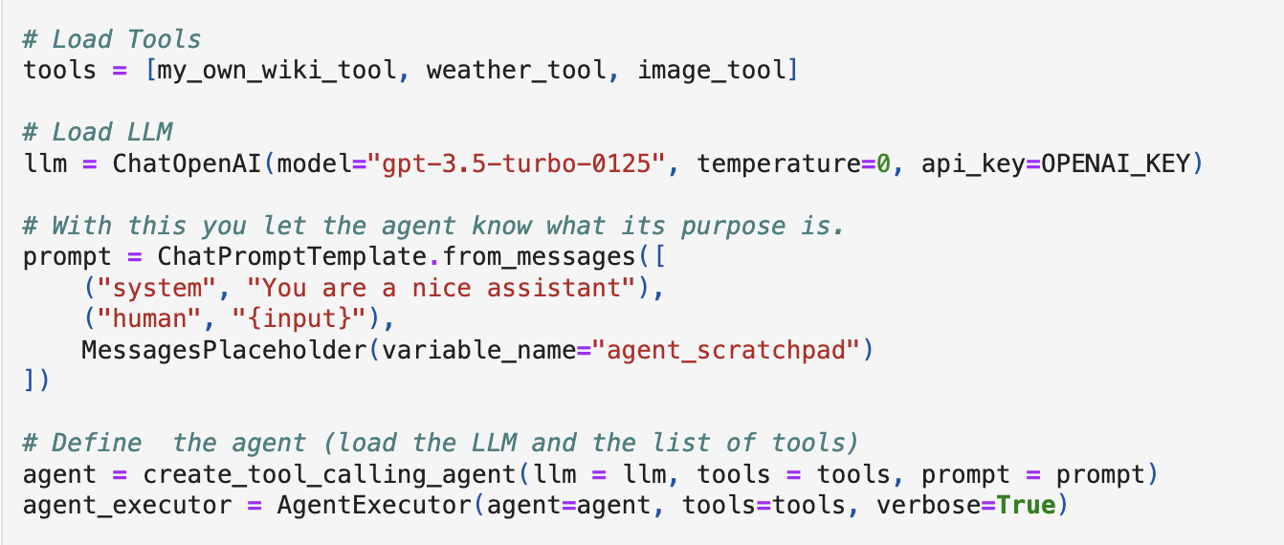
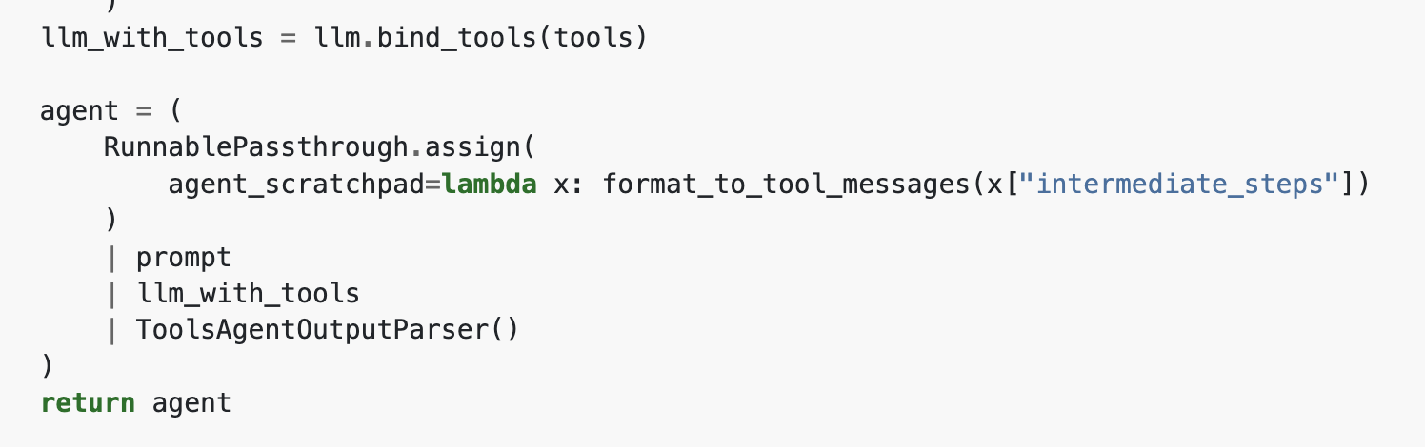
Agents with LangChain
Allow and LLM to choose a sequence of actions from a list of tools.
Tools, prompt, LLM and scratchpad are combined into a runnable chain.
👉 2_workshop_agents.ipynb
[source]

Slide 24
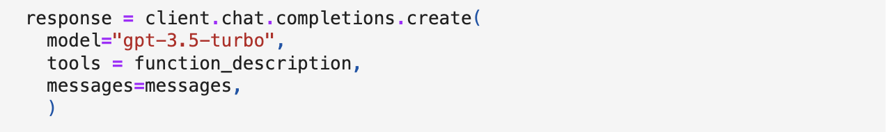
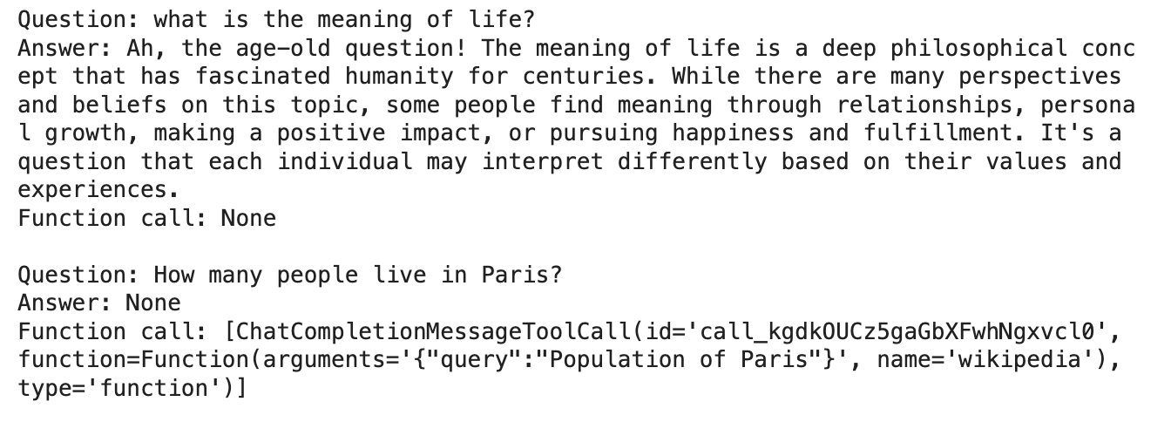
Why does this all work?
An LLM can either output a string response or a function call.
👉
…
👉
while [LLM output is function call]:
Execute the functions Try to answer the questions with the function output
👉 3_workshop_advanced.ipynb
(optional)

Slide 25


Thank you
Scan to connect with
Ana Chaloska
Scan to connect with
Maria Bader
x

